Slide 1
Competitive Algorithm Calculation Testing in a Unified System
(C.A.C.T.U.S.)
Detailed Design
Presented By:
ExoNET Solutions
3/1/2011

Slide 2
Welcome
Dr. Darren Lim
Associate Professor of Computer Science
Siena College

Slide 3
Agenda
Introductions
Problem Overview
Project Status
Prototype Screens
Data Design
Testing
Unit Tests
Timeline
What is next for ExoNET?
ExoNET Solutions - Detailed Design

Slide 4
ExoNET Solutions Team Members
Stephanie Del Belso
Team Leader
David Purcell
Lead Programmer
Thomas Delaney
Database Admin/ System Admin
Marco Samaritoni
Testing Manager
Paul Amodeo
Web Master/ Interface Expert

Slide 5
Agenda
Introductions
Problem Overview
Project Status
Prototype Screens
Data Design
Testing
Unit Tests
Timeline
What is next for ExoNET?

Slide 6
Problem Overview
Current contest system is loosely structured
Inconvenient for judges and contestants
Not easily maintained
Not fully automated

Slide 7
Agenda
Introductions
Problem Overview
Project Status
Prototype Screens
Data Design
Testing
Unit Tests
Timeline
What is next for ExoNET?

Slide 8
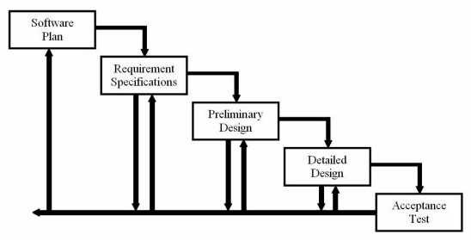
Project Status
Development
and
Testing
Detailed Design

Slide 9
Agenda
Introductions
Problem Overview
Project Status
Prototype Screens
Data Design
Testing
Unit Tests
Timeline
What is next for ExoNET?

Slide 10
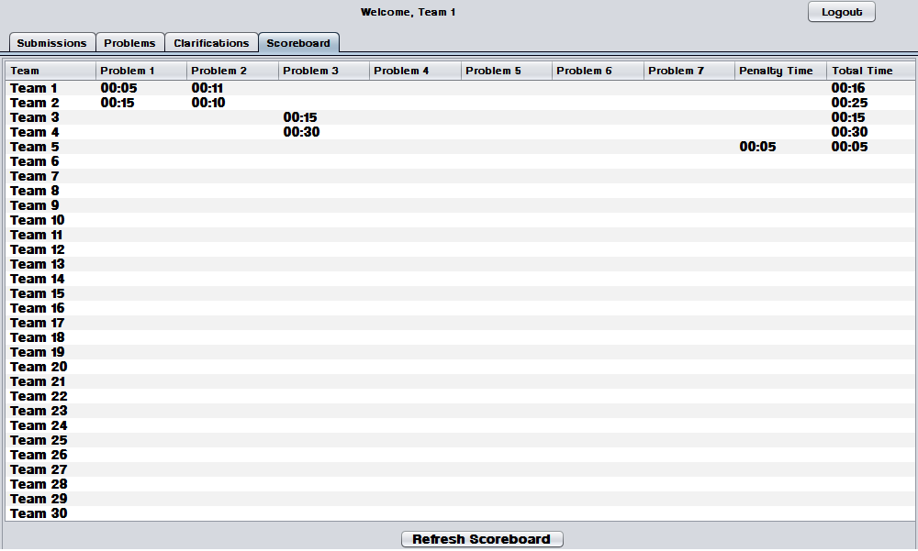
Prototype-Scoreboard

Slide 11
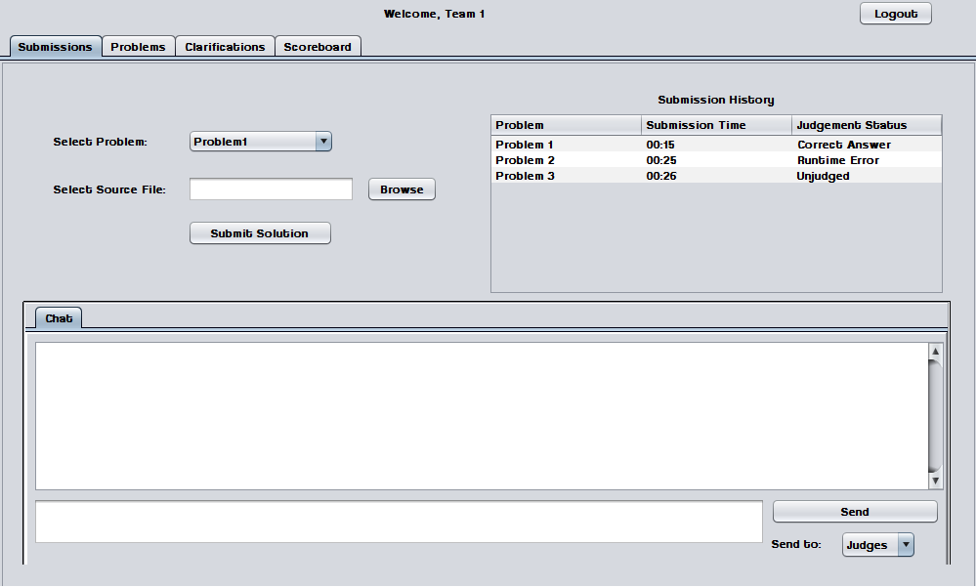
Prototype-Contestant Submission Tab

Slide 12
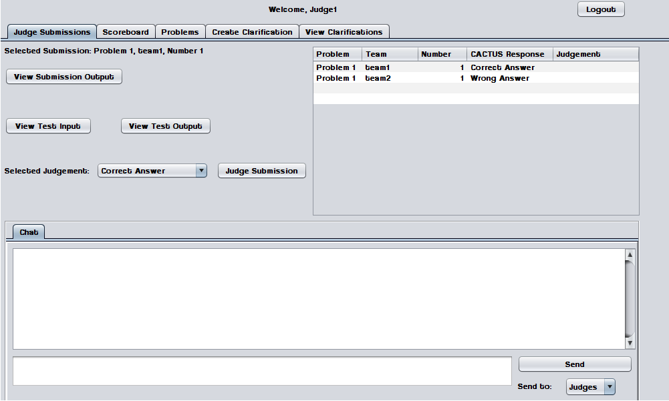
Prototype-Judge Submissions Tab

Slide 13
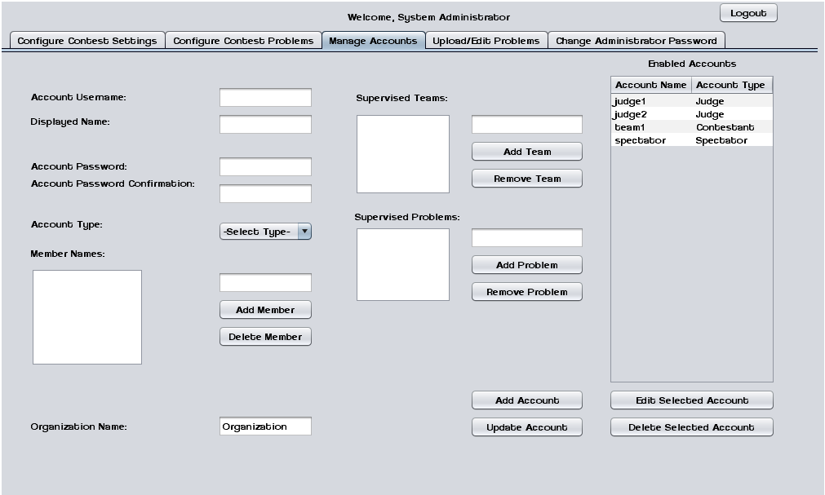
Prototype-System Administrator Manage Accounts Tab

Slide 14
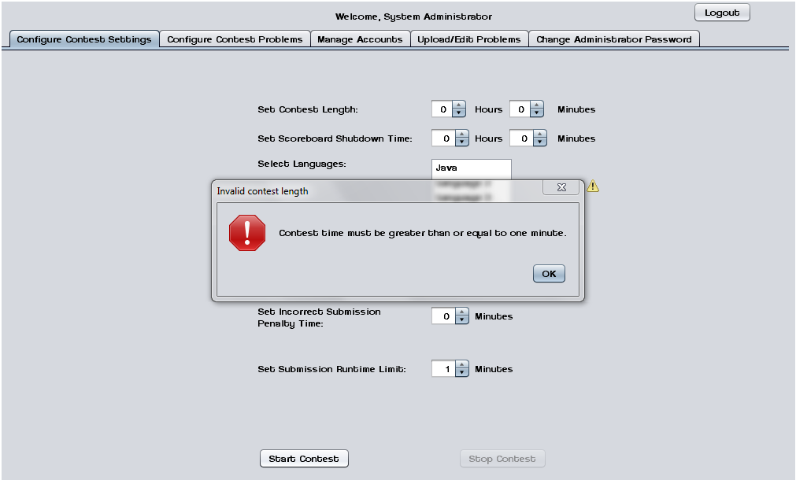
Prototype-System Administrator Configure Contest Settings Tab (Error Message)

Slide 15
Agenda
Introductions
Problem Overview
Project Status
Prototype Screens
Data Design
Testing
Unit Tests
Timeline
What is next for ExoNET?

Slide 16
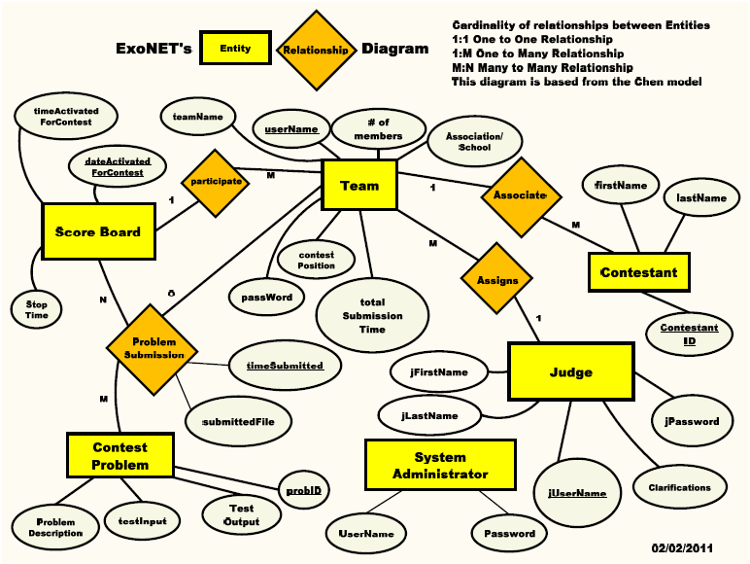
ER Diagram

Slide 17
Database Relational Schema
Scoreboard(date dateActivatedForContest(PrimaryKey),date timeActivatedForContest,Integer stopTime, date timeSubmission(references ProblemSubmission(timeSubmitted)))
ContestProblem(Integer probID(Primary Key), File test Output, File testInput, File problemDescription)
Judge(String jUserName(PrimaryKey), String[] Clarifications, String jPassword, String jLastName, String jFirstName)
Contestant(Integer ContestantID(Primary Key), String firstName, String lastName, String teamName (references Team(userName)))
ProblemSubmission(date timeSubmitted(Primary Key), File submittedFile, String teamName(references Team(userName)),Integer contestNumber(references ContestProblem(probID)))
Team(date totalSubmissionTime, String password, Integer contestPosition, String username(Primary Key), Integer numberOfMembers, String Association/School, date timeforContest(references Scoreboard(dateActivatedForContest)),String judge(references(Judge(jusername)))

Slide 18
Agenda
Introductions
Problem Overview
Project Status
Prototype Screens
Data Design
Testing
Unit Tests
Timeline
What is next for ExoNET?

Slide 19
Testing - Overview and Strategy
Testing consists of multiple test cases for each type of user in the system
These tests are used to measure the overall performance of the system
Tests include: Unit Test, Integration Test, System Test, Performance Test and Acceptance Test

Slide 20
Testing - Integration Test
Tests how well different components of C.A.C.T.U.S interact with each other
Each individual component must first have a successful Unit Test

Slide 21
Testing - System Test
Ensures that the system meets all Functional Requirements
The Functional Requirements Inventory contains a list of specifications for each type of user

Slide 22
Testing – Performance Test
Ensures that C.A.C.T.U.S. functions even with a large number of users
The nature of this project requires that the system be able to handle traffic from a large number of users

Slide 23
Testing – Acceptance Test
The final test to validate the system
Tests that the system meets both Functional and Non-Functional Requirements

Slide 24
Agenda
Introductions
Problem Overview
Project Status
Prototype Screens
Data Design
Testing
Unit Tests
Timeline
What is next for ExoNET?

Slide 25
Unit Tests
Serve as the backbone of the Test Plan
Based on the functionality of a single component of the system
Comprised of many Test Cases, which are individual members of a Unit Test

Slide 26
Agenda
Introductions
Problem Overview
Project Status
Prototype Screens
Data Design
Testing
Unit Tests
Timeline
What is next for ExoNET?

Slide 27
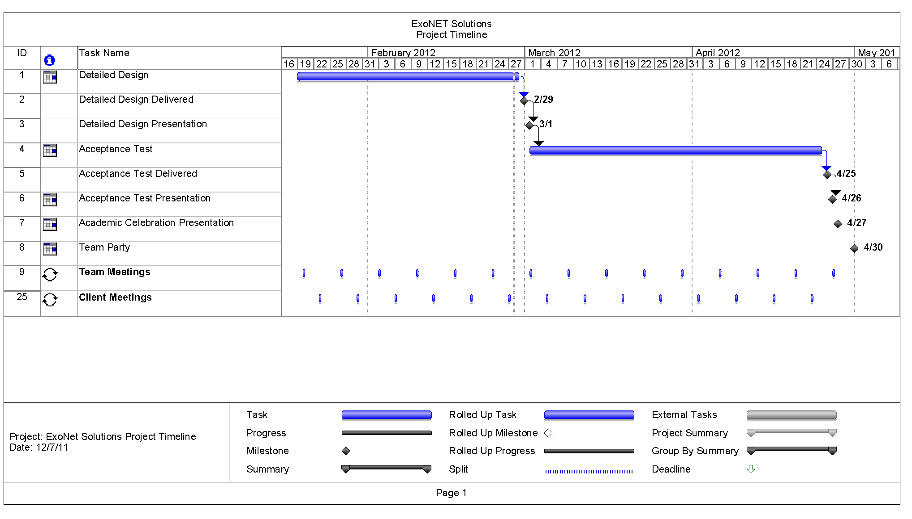
Timeline

Slide 28
Agenda
Introductions
Problem Overview
Project Status
Prototype Screens
Data Design
Testing
Unit Tests
Timeline
What is next for ExoNET?

Slide 29
What is next for ExoNET?
Acceptance Test Delivered – April 25th, 2012
Acceptance Test Presentation – April 26th, 2012
Academic Celebration Demonstration – April 27th 2012

Slide 30
Thank You.
Questions? Comments?

